Slide 1
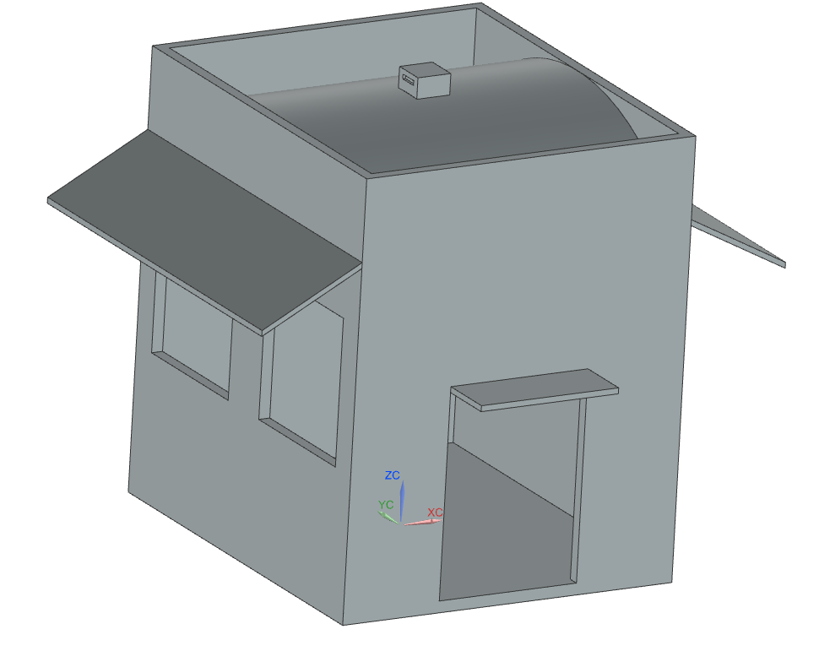
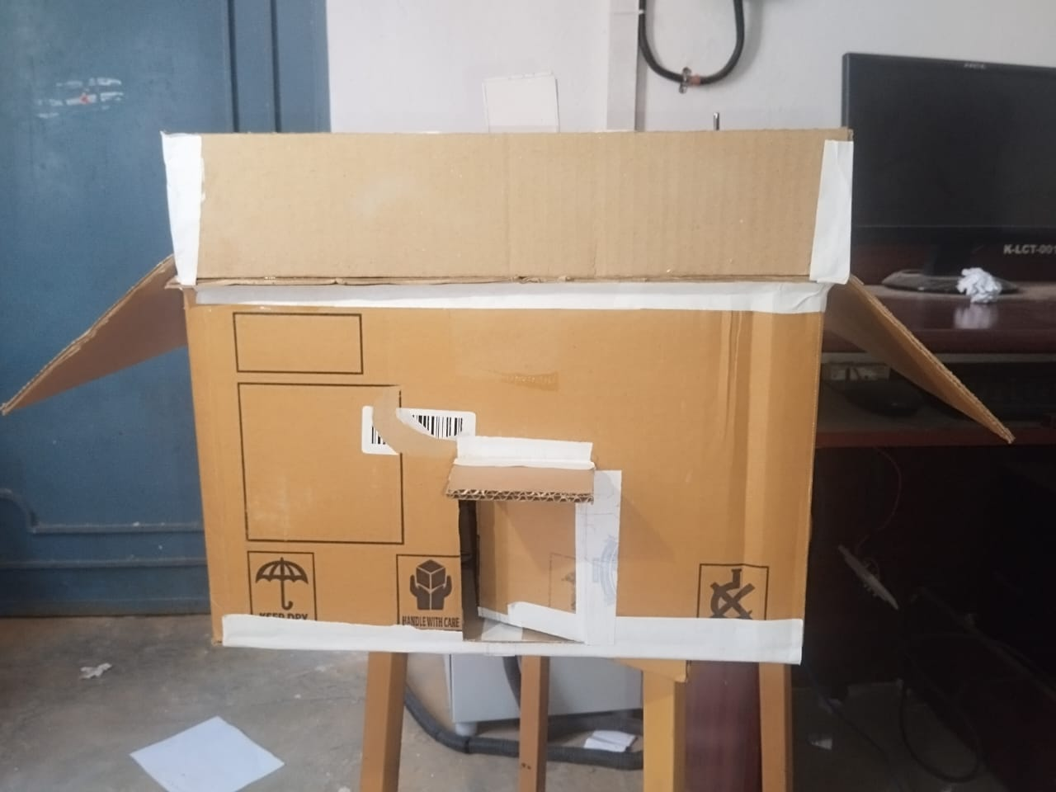
PASSIVE COOLING FOR HOME
Project Abstract
Rapid urbanization and rising global temperatures have increased dependence on mechanical air-conditioning, driving up energy consumption and
environmental impact. This project designs and validates a passive cooling home that maintains indoor thermal comfort without electrical cooling
systems. A compact semi-cylindrical dome shaped prototype (max. 600mm x 600mm x 600mm) was built to enhance natural air circulation and
reduce heat gain, combining stack-effect and Venturi-assisted ventilation with reflective surfaces. Indoor temperature remained consistently 2-3 deg C
lower than outdoor conditions, confirming passive cooling as a low-cost, sustainable alternative for hot, tropical residential buildings.
Problem Statement
Conventional air-conditioning consumes large amounts of electrical energy and contributes to carbon emissions, yet most residential designs in hot
regions like Tamil Nadu do not use climate-responsive features. There is a clear need for a low-cost, energy-efficient cooling approach that reduces
indoor heat without mechanical or electrical systems.
Need for the Project
The project provides a sustainable, low-energy cooling alternative that reduces electricity consumption and carbon footprint while improving thermal
comfort. It demonstrates how architectural geometry and material selection alone can be used to fight heat gain in tropical climates.
Project Objectives
Design a passive cooling home using a semi-cylindrical dome roof for enhanced natural ventilation.
Reduce indoor heat gain using stack effect, Venturi effect, and reflective surface treatment.
Validate cooling performance experimentally using temperature sensors and data logging.
Establish a low-cost, scalable design pathway to full-scale residential construction.
Components and Materials
Scaled Prototype: Cardboard, foam board, hot glue gun, DS18B20 temperature sensors, RTC module, SD card module, 8 GB memory card, CR2032 cell, jumper wires.
Full-Scale Residential Application: AAC blocks, thin-bed AAC jointing mortar, reinforcement steel bars, cement-lime plaster, exterior solar-reflective paint, low-emissivity (Low-E) glass, steel door frames, natural clay tiles, insulated UPVC door.
Methodology / Workflow
Literature Review → Problem Identification & Objectives → Conceptual Design → 3D Modeling & Prototype Design → Material Selection → Prototype
Fabrication → Instrumentation & Setup → Data Collection → Results & Analysis → Conclusion & Future Scope
Working Principle
Cooling is driven entirely by natural physical phenomena. Ambient air enters through large side window openings, absorbs sensible heat, becomes
buoyant, and rises along the corner-free curved dome surface (stack effect), escaping through a small top opening that acts as a passive air extractor.
Air accelerating from the large inlet openings to smaller exit regions increases velocity and lowers static pressure (Venturi effect), further
strengthening indoor air circulation. An exterior reflective coating limits solar heat absorption into the structure.
CAD Model / Prototype
Experimental Setup
The scaled cardboard prototype (60 cm x 60 cm) was instrumented with DS18B20 sensors placed at inlet and outlet locations to record indoor (t2)
and outdoor (t1) temperatures. An RTC module time-stamped each reading, and an SD card module logged the data for post processing under real
outdoor exposure conditions.
Recorded Data (sample)
Results
Performance Evaluation
Challenges Encountered
Challenge: Cardboard does not replicate real building thermal mass or conductivity.
Solution: Used foam board (low k, approx. 0.03-0.05 W/m.K) for walls/roof to isolate and clearly observe airflow-driven cooling rather than material heat storage.
Challenge: Reliable time-synced data logging outdoors.
Solution: Combined RTC module + SD card logging for continuous, non-volatile, time-stamped temperature records.
Innovation / Novel Features
A corner-free semi-cylindrical dome roof that jointly exploits the stack effect and Venturi effect for continuous passive ventilation, paired with
a direct materials pathway (AAC blocks, Low-E glass, reflective coatings) from low-cost prototype to full-scale residential construction.
Applications
Residential buildings in hot, dry regions
Low-cost and rural housing projects
Temporary shelters / emergency housing
Schools, hostels, and community halls
Future Scope
  Full-scale build using AAC blocks, reflective coatings, and Low-E glass
  CFD validation using ANSYS / Energy Plus simulation
  Integration of wind catchers, roof ventilators, earth-air tunnels
  IoT-based long-term seasonal monitoring; solar panel integration
Time | Outdoor T1 (°C) | Indoor T2 (°C)
9:30 AM | 30.12 | 27.55
10:00 AM | 29.10 | 27.01
11:00 AM | 28.90 | 26.30
12:00 AM | 28.50 | 26.19
1:00 PM | 26.90 | 25.17
Module | Result
Prototype Fabrication | Semi-cylindrical dome cardboard prototype successfully built
Temperature Monitoring | Indoor vs outdoor temperature logged continuously via RTC + SD card
Cooling Performance | Indoor temperature stayed 2-3°C lower than outdoor, especially at peak exposure
Airflow Behaviour | Noticeable natural airflow confirmed combined stack + Venturi effect
Metric | Outcomes
Indoor Temperature Reduction | Approx. 2-3°C vs outdoor
Cooling Method | Fully passive, no electrical input
Prototype Cost | Rs. 1,420 (scaled model)
Full-Scale Estimated Cost | Rs. 56,000 (materials)
System Stability | Consistent cooling trend across observation period
Qsolar = α I A | ΔP = ρgH (Ti - To) / To | Qair = ṁ cp (Ti - To)
Skills Acquired
  Technical Skill: 3D CAD modeling, CFD simulation (ANSYS Workbench), heat transfer analysis, sensor interfacing (DS18B20), RTC, SD card, data logging & analysis
  Soft Skill: Teamwork, field research, technical documentation, project management.
Project Outcomes
A working passive-cooling prototype was developed and experimentally validated, demonstrating a 2-3°C indoor temperature reduction without any mechanical cooling, confirming the feasibility of dome-based passive cooling for sustainable, low-energy residential design in hot and tropical climates.
References
Givoni, B. (1998). Climate Considerations in Building and Urban Design.
John Wiley & Sons. Santamouris, M., & Asimakopoulos, D. (2001).Passive cooling of buildings.
Prianto, E., & Depecker, P. (2008). Impact of building geometry on ventilation efficiency.
Nair, V. et al. (2019). Venturi effect-based natural ventilation in residential buildings.
Acknowledgements
Dr. K.S. Prabhakaran (HOD) & Mr. A. Kamalakkannan (Supervisor), Dept. of Mechanical Engineering, KIOT, Salem.
[Insert QR Code]
QR Code — Project Report (PDF) | Source Code Repository | Demonstration Video
Contact information
Department of Mechanical engineering, Knowledge Institute of Technology, Salem
Email: 2k23me013@kiot.ac.in | www.kiot.ac.in

